Slide 1
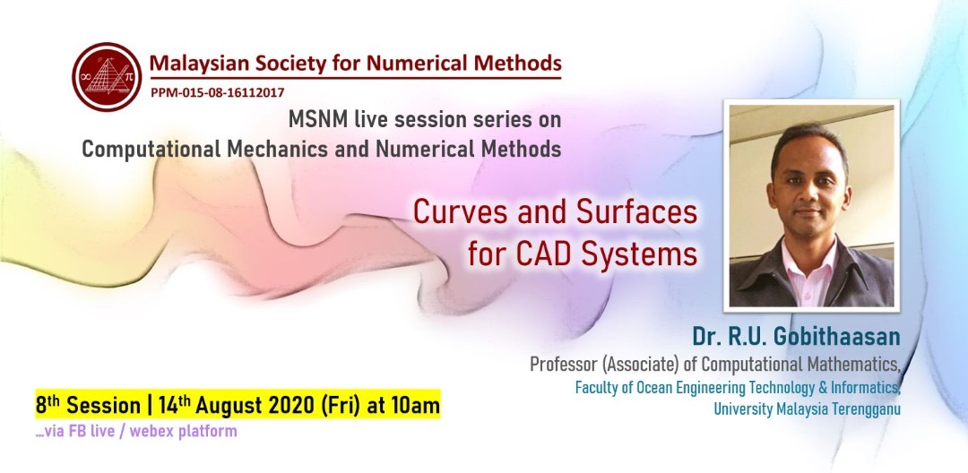


Slide 2
Table of Content
History of CAGD: Past & Present
1
Computer- Aided X
Bezier & B-Splines
de facto of curve design
2
Various Kind of Surfaces
Extension to surfaces
3
Some of my personal works: LACs
3
Looking ahead

Slide 3


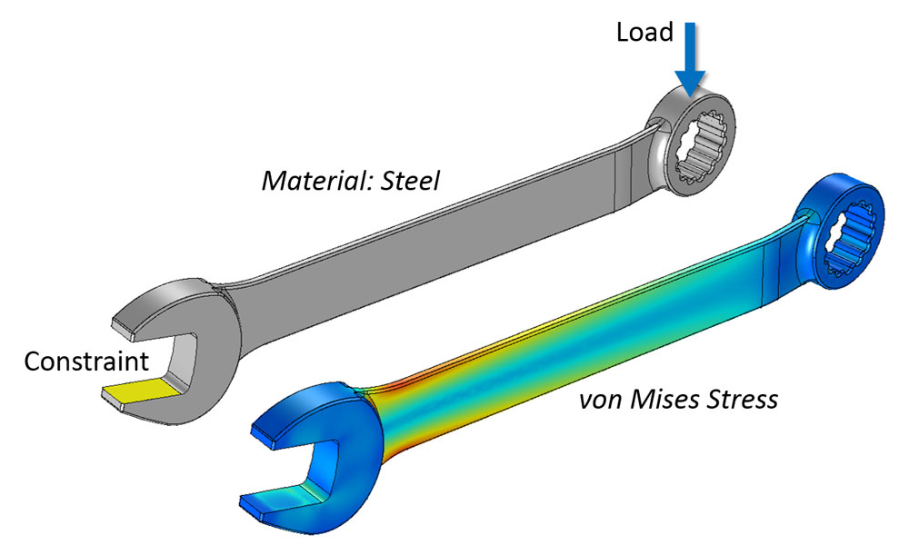
Motivation
glyph

Slide 4
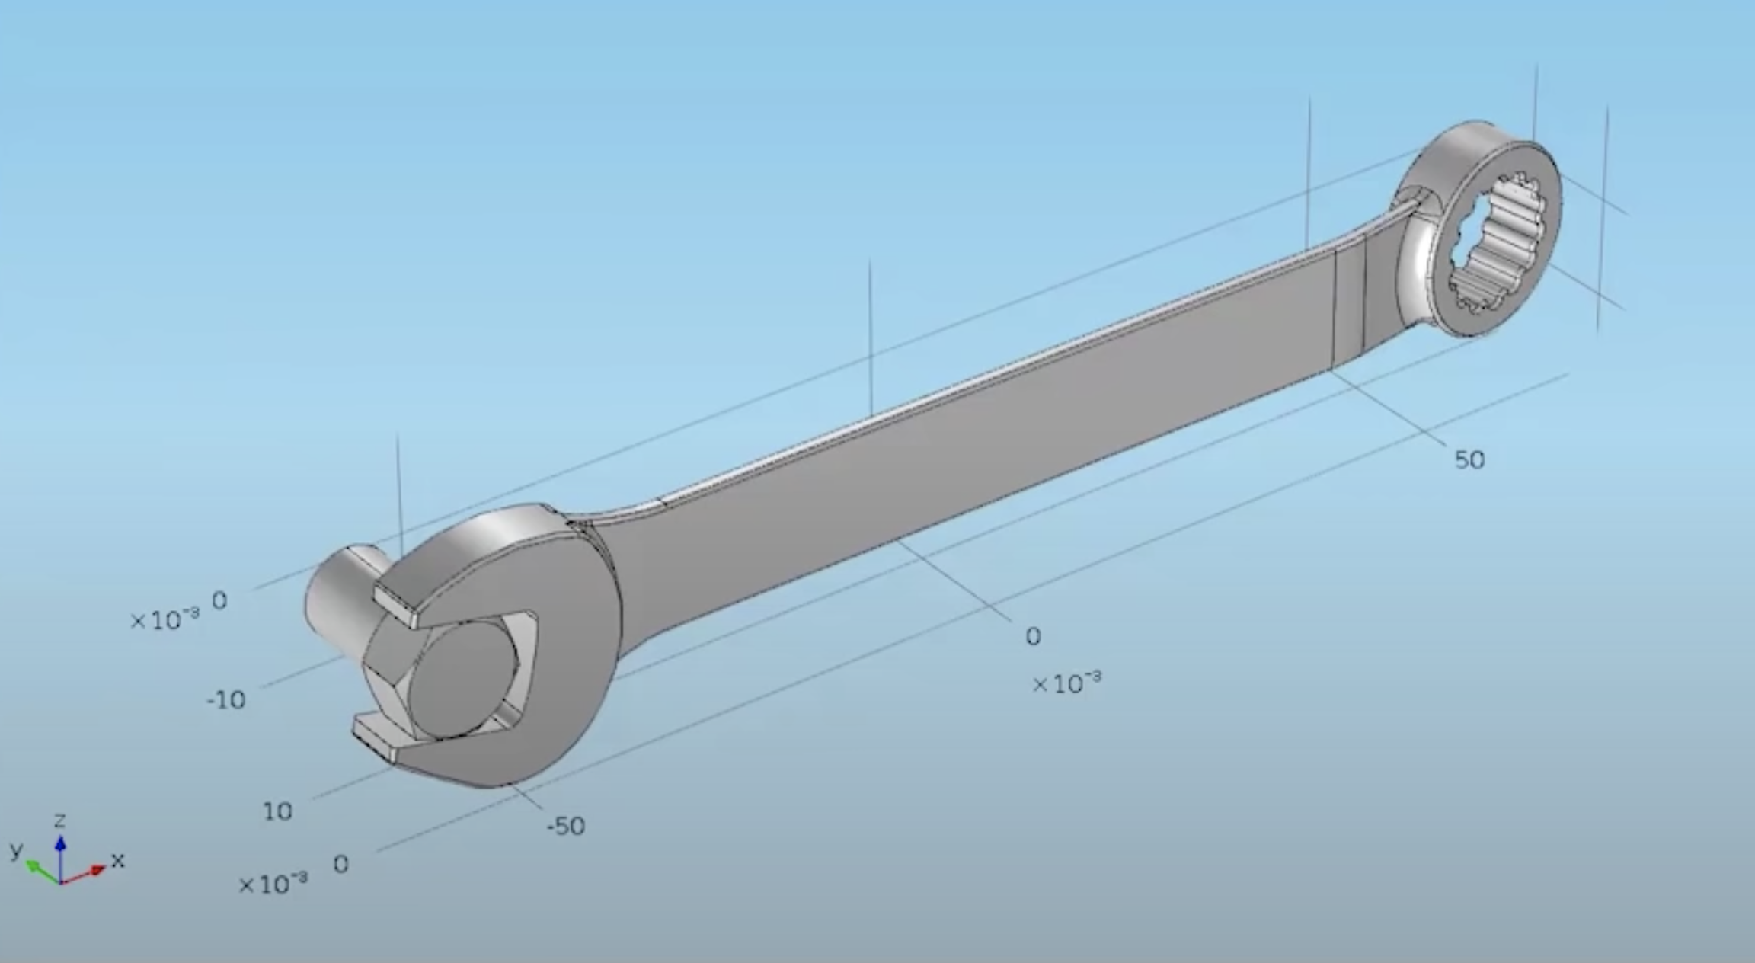
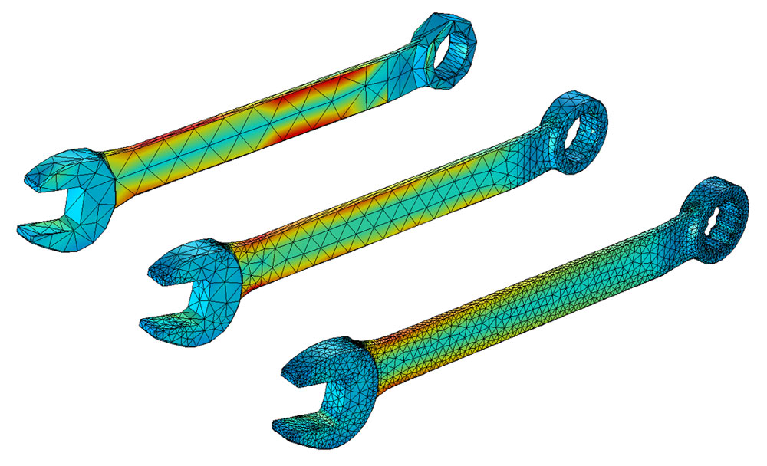
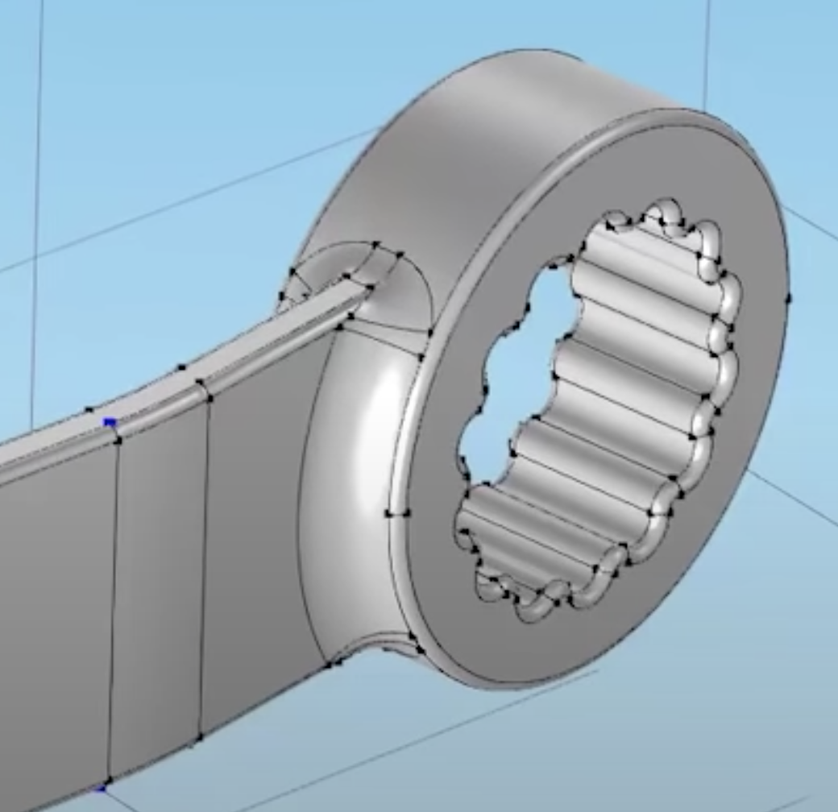
CAD: Exact representation of shape & structure
CAE: Discretization of the shape (approximation)
https://www.youtube.com/watch?v=GjSdI9lxpy8
https://www.comsol.com/multiphysics/mesh-refinement
Notes:
CAD vs CAE

Slide 5
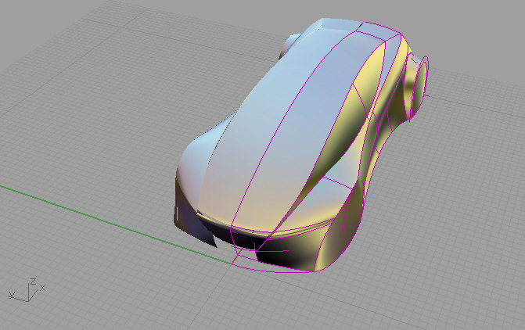
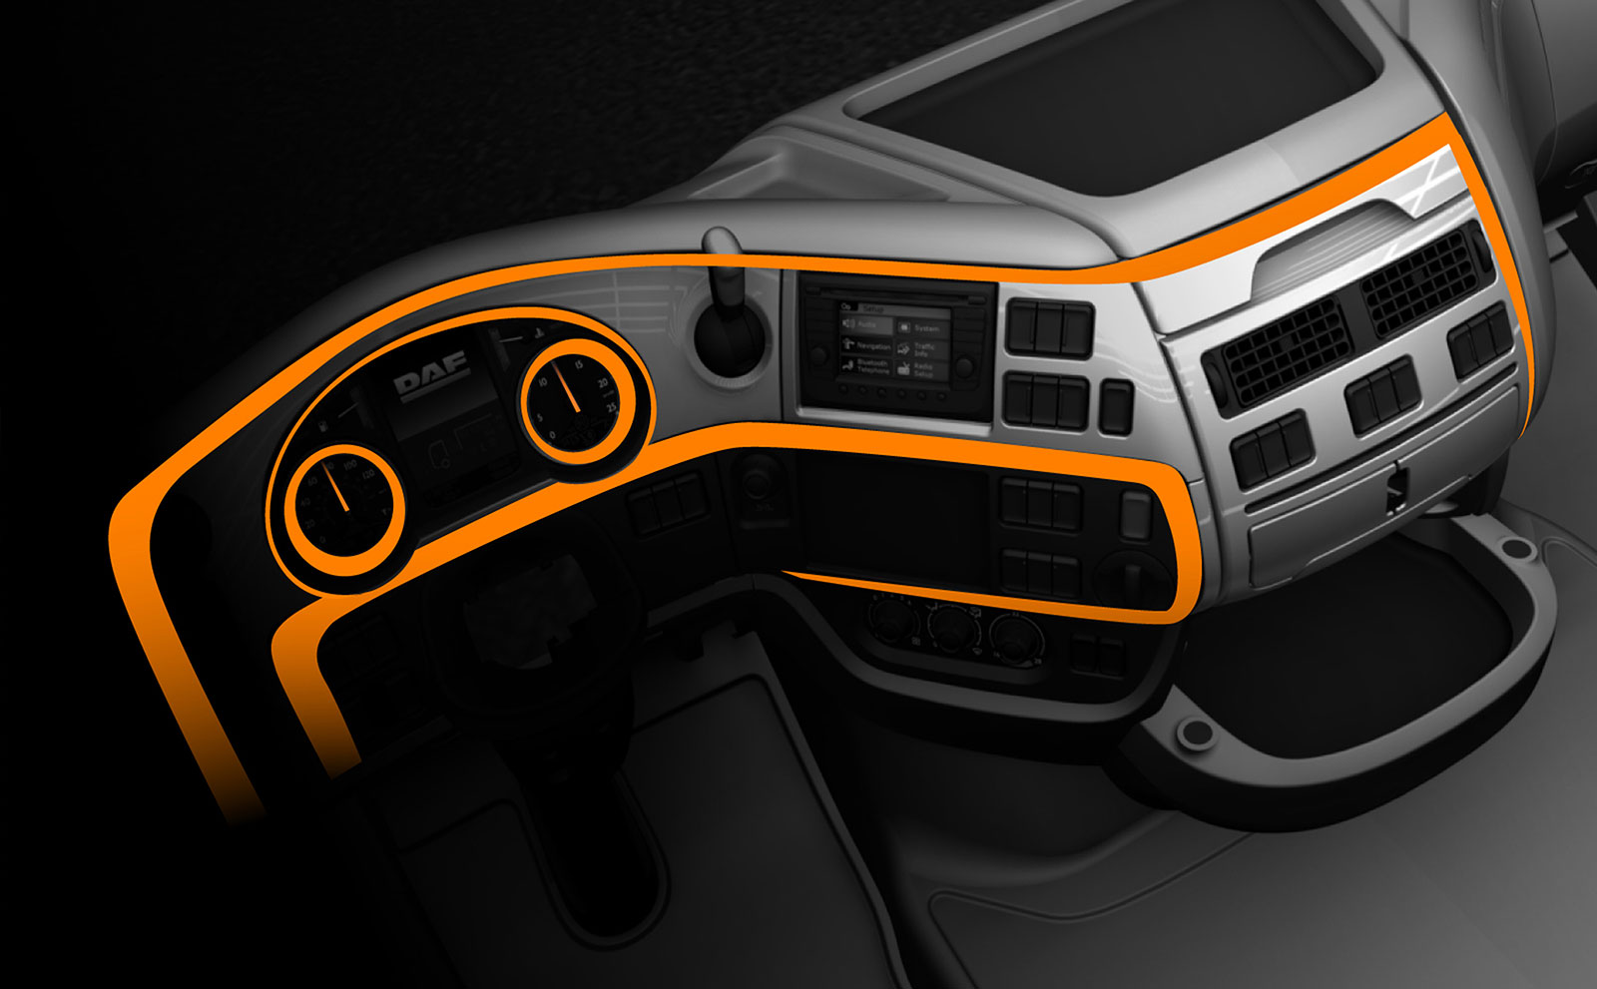
What’s in a surface?
Interior keylines
https://www.carbodydesign.com/gallery/2013/04/exclusive-daf-xf-design-story/13/
KT Miura, D Shibuya, RU Gobithaasan, S Usuki, Designing Log-aesthetic Splines with G2 continuity, Computer-Aided Design and Applications 10 (6), 1021-1032

Slide 6

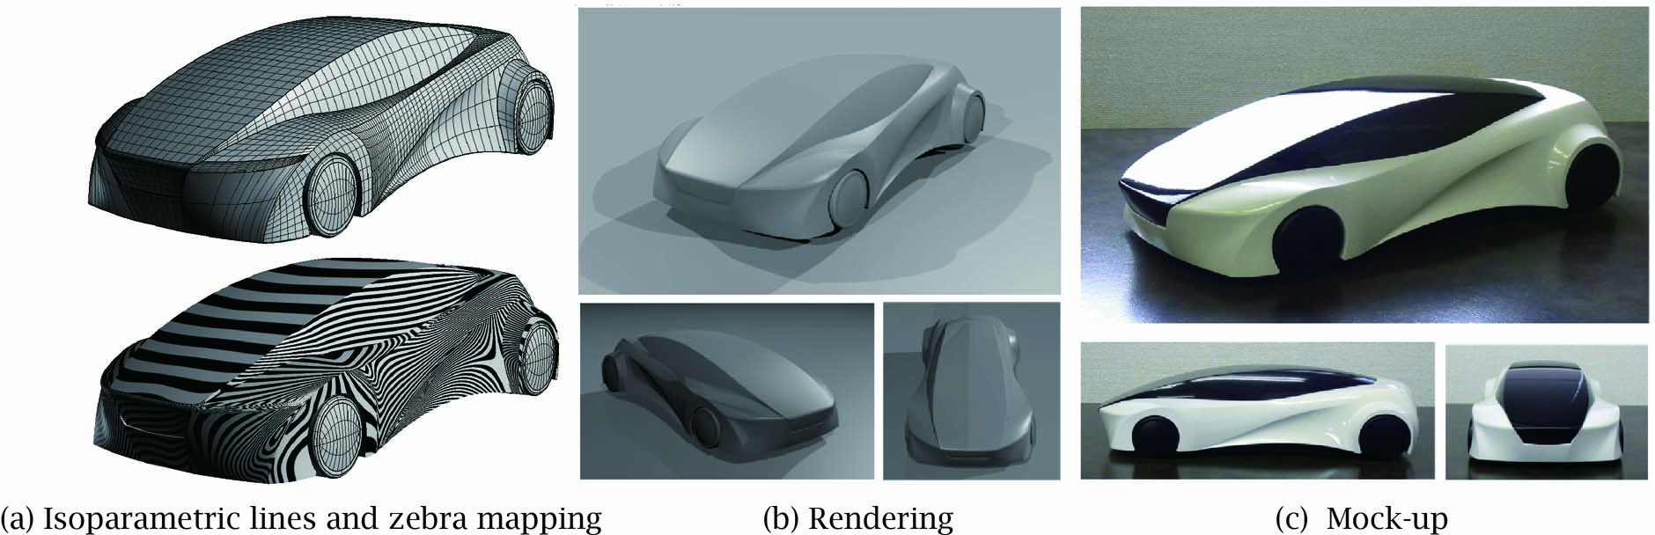
Whats in a surface?
KT Miura, D Shibuya, RU Gobithaasan, S Usuki, Designing Log-aesthetic Splines with G2 continuity, Computer-Aided Design and Applications 10 (6), 1021-1032

Slide 7
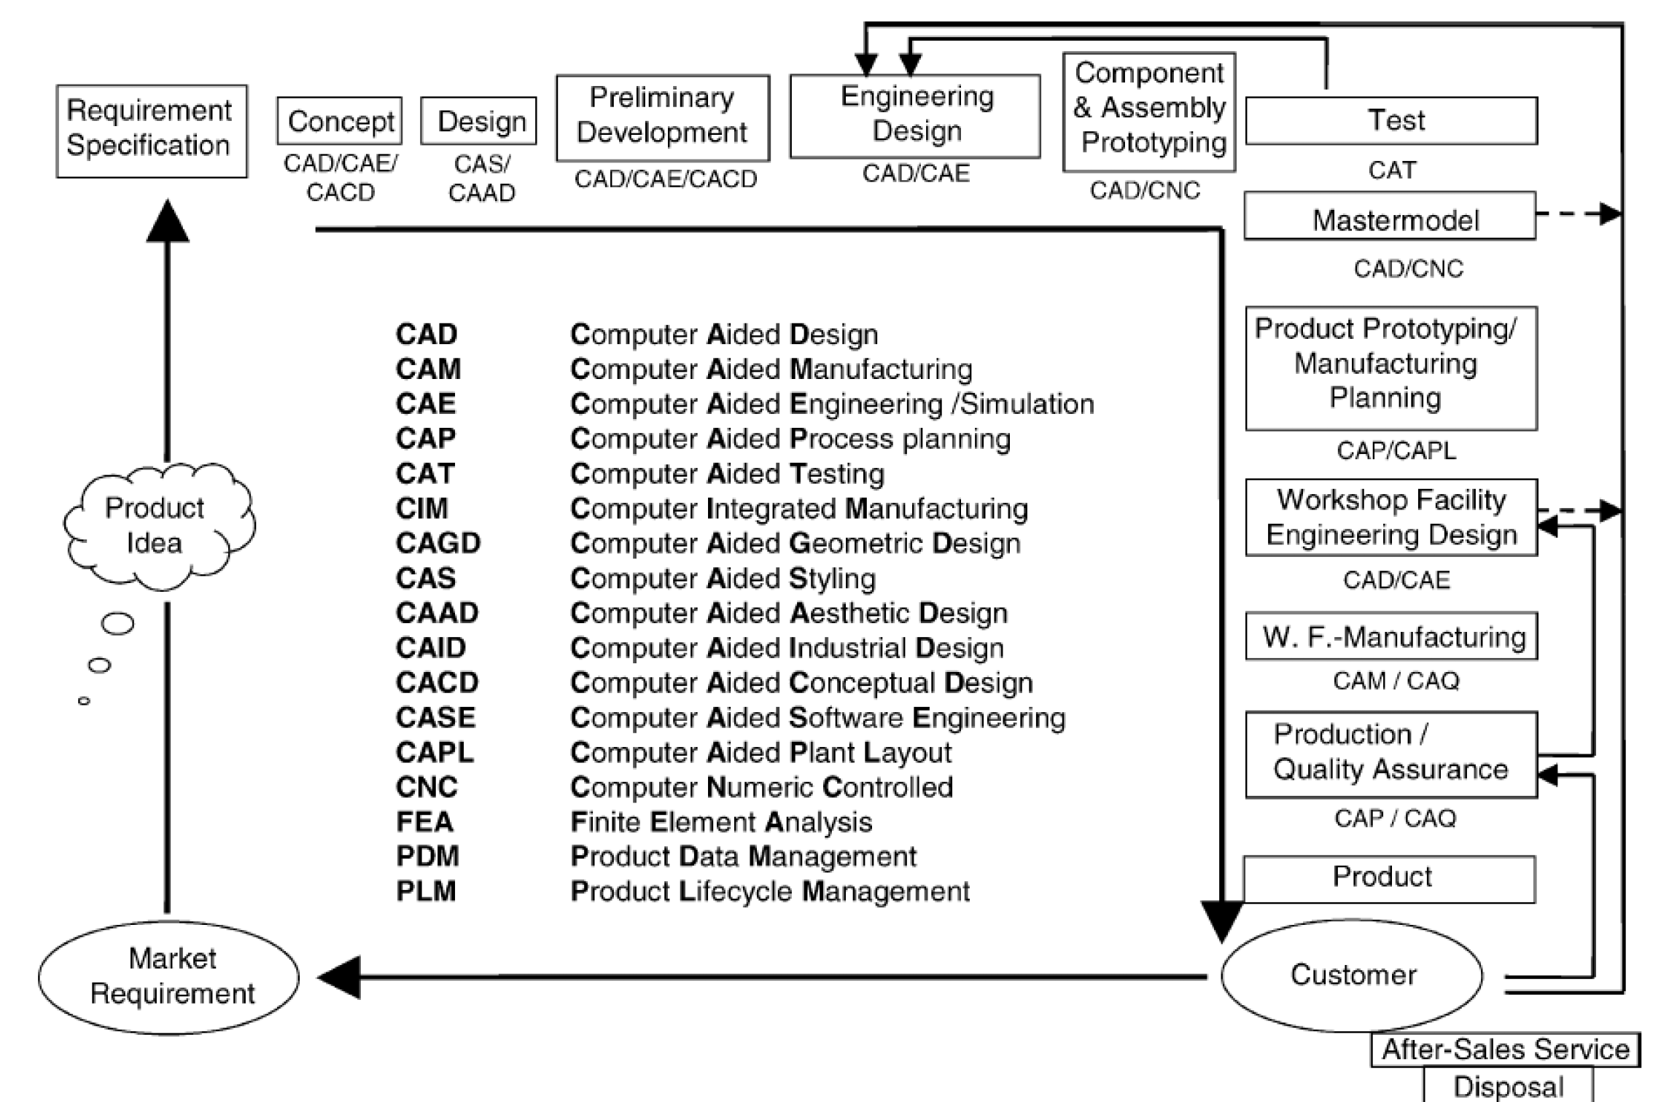
CA-x: Product Lifecycle
C. W. Dankwort, R. Weidlich, B. Guenther, and J. E. Blaurock. Engineers' Cax education{it's not only CAD. Computer-Aided Design, 36(14):1439-1450, 2004.
Notes:
General process chain of product development

Slide 8


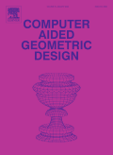
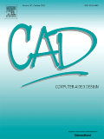


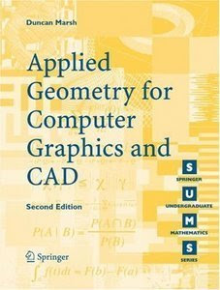
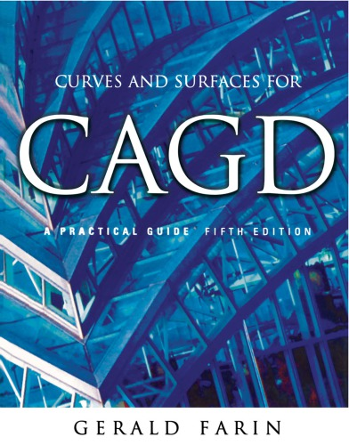
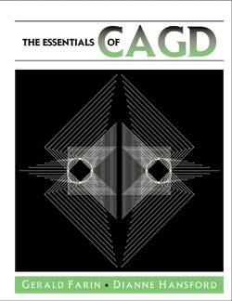
Keyword:
Computer Aided Geometric Design (CAGD)
Rekabentuk Geometri Berbantu Komputer (RGBK)
Approximation Theory;
Computational Geometry;
Differential Geometry;
Curve, Surface, and Solid;
Computer-Aided-x (CAx);

Slide 9
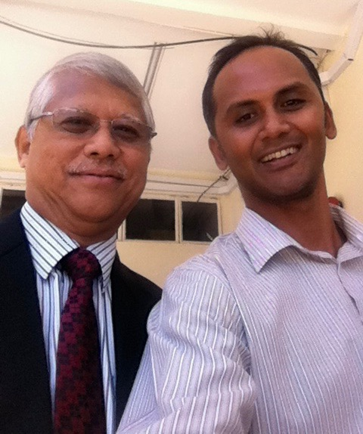
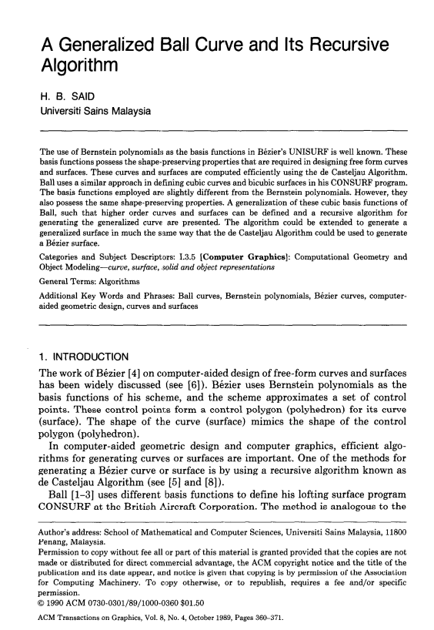
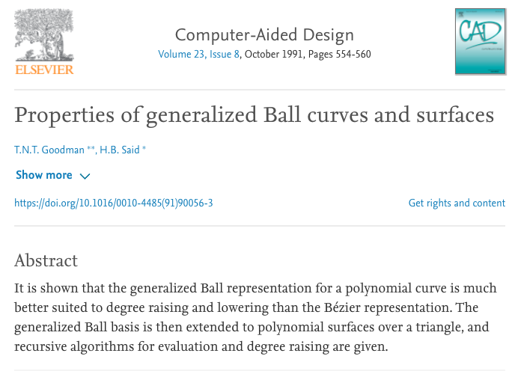
CAGD: Malaysia
USM (School of Math. Sc.); spearheaded by Prof. Dato Hasan Said / Prof. S. L. Lee
CAGD Experts served at USM:
T.N.T Goodman
Keith Unsworth
USM Supervisor:
Prof J. M. Ali
Supervised by Prof Alan Ball (CAD of British Airways)
Profesor Emeritus Datuk Dr Hasan Said Naib

Slide 10
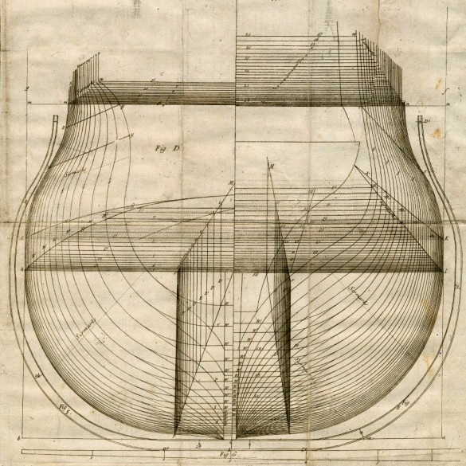
CAGD: History
1700s; A ship’s body plan comprised of superimposed construction geometry.

Slide 11
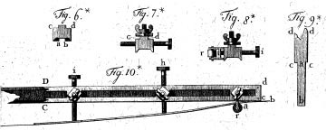
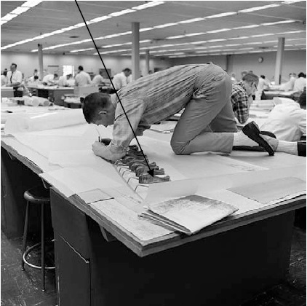
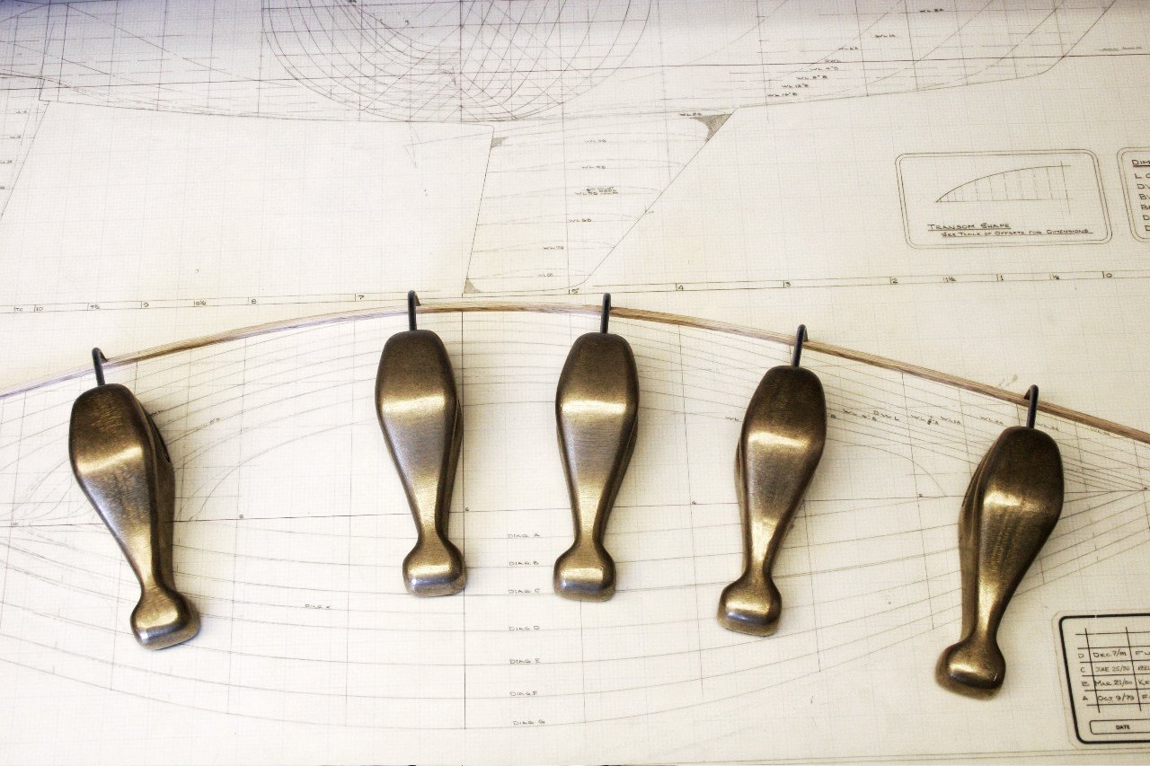
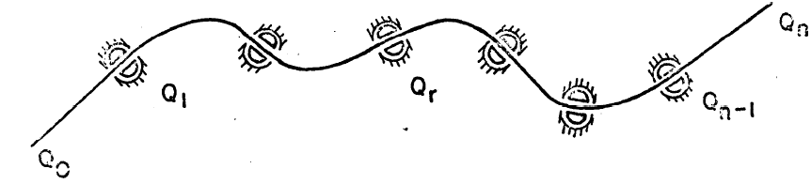
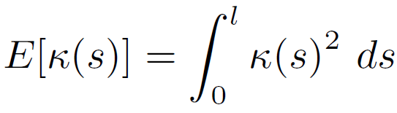
Ducks & Mechanical splines
Hooked weights, called “ducks,” accurately traces a spline.
Schoenberg *1946: polynomial spline of order k ≈ Minimum Energy Curve (MEC)

Slide 12
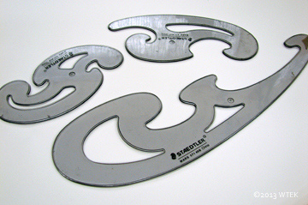
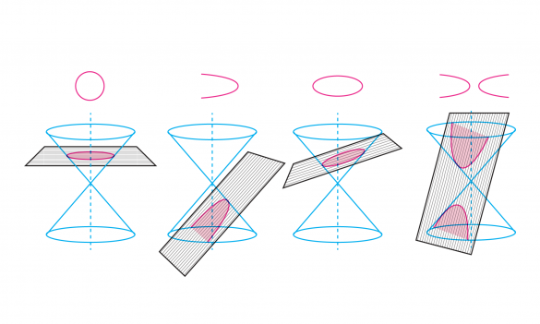
French curves
Set of French Curves devised by the German kinematician and geometer Ludwig Burmester.
The shapes are segments of clothoid curves & conic section
Conic sections: e.g. aircraft design (Consurf for British Aircraft Corporation developed by A.A. Ball used birational cubic)

Slide 13
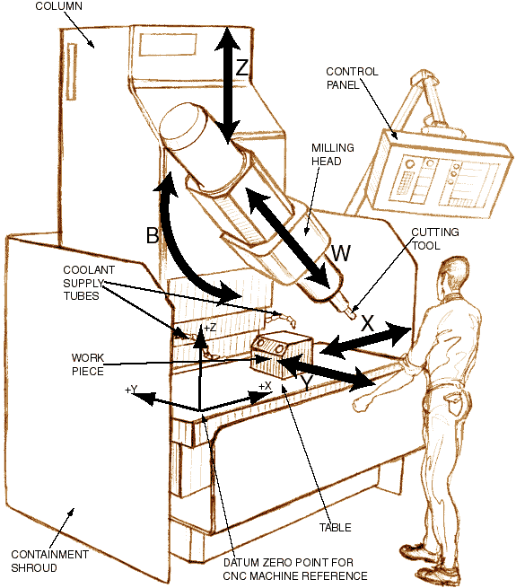
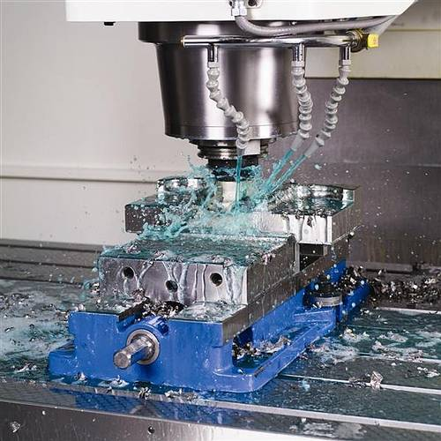
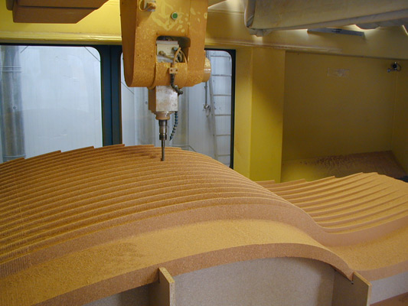
CAGD Precursor: Numerical Controls (1950s)

Slide 14
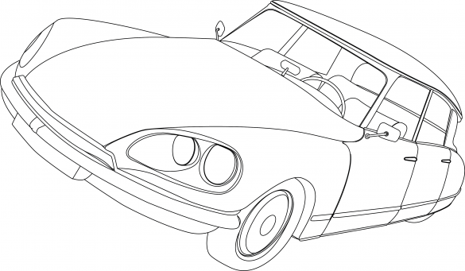
CAGD Precursor (past and present): Automobile industry
Citroën’s DS 19 was introduced at the 1955 at the Paris Motor Show.
Within the first 15 minutes of the show, 743 orders were received.

Slide 15



CAGD Precursor (new): Animations/VR/AR

Slide 16
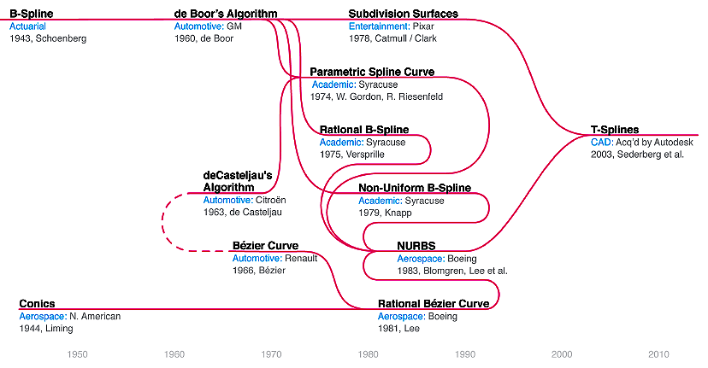
Timeline of flexible curves/surfaces

Slide 17
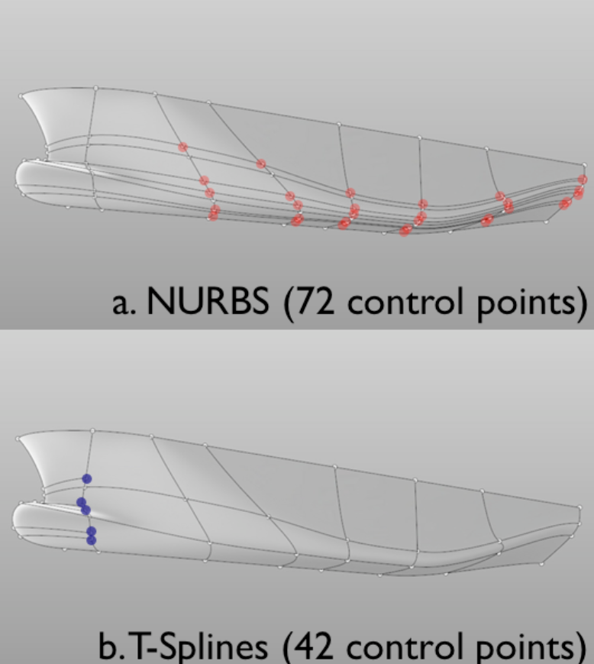
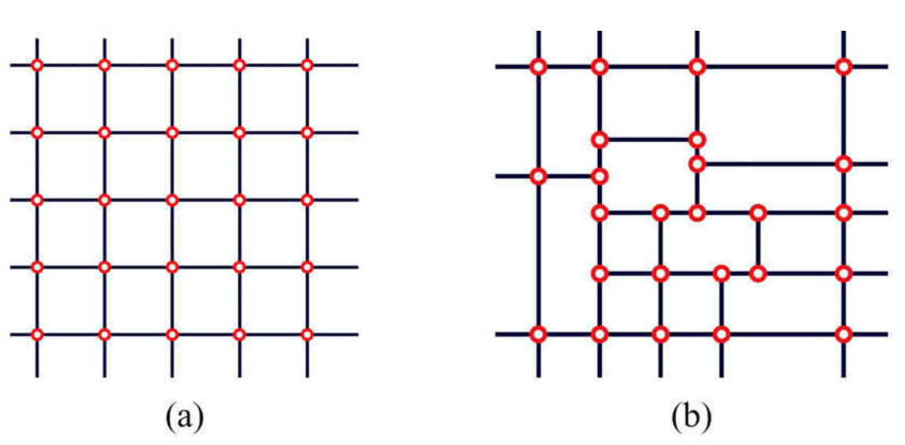
Interlude: T-Splines
Bazilevs et al, Isogeometric analysis using T-spline, Vol. 199, Issues 5–8, 2010, Pages 229-263
M.T Sederberg, T.W. Sederberg,T-Splines: A Technology for Marine Design with Minimal Control Points.

Slide 18
Bezier Curves!
Mathematics of shapes

Slide 19
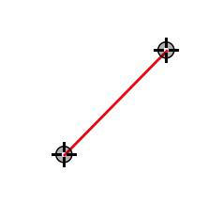
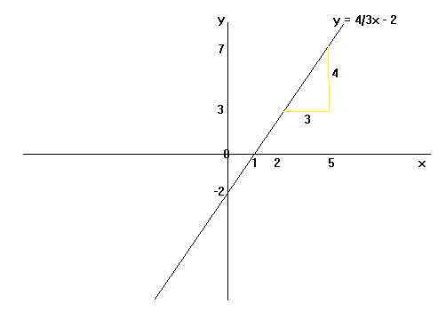
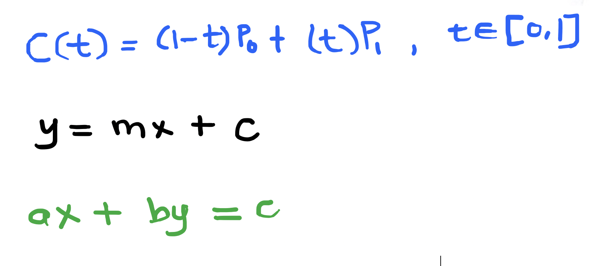
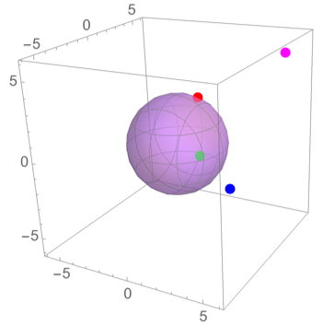
Curve representation, which is suitable?
x^2 + y^2 + z^2 =10

Slide 20
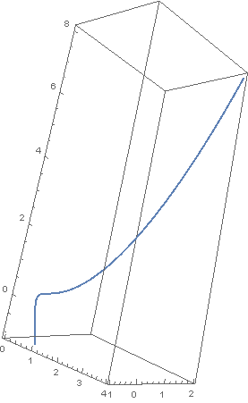
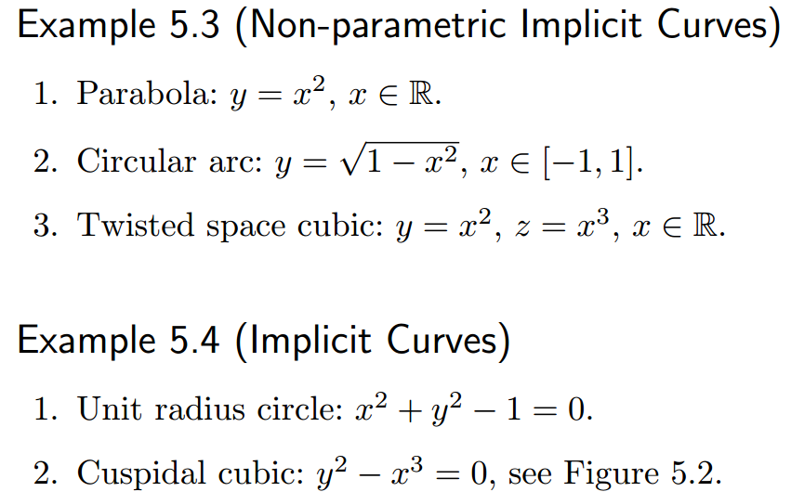
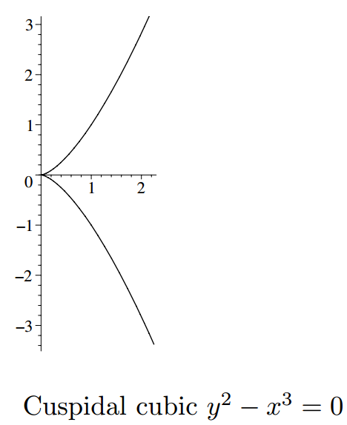
Explicit & Implicit

Slide 21
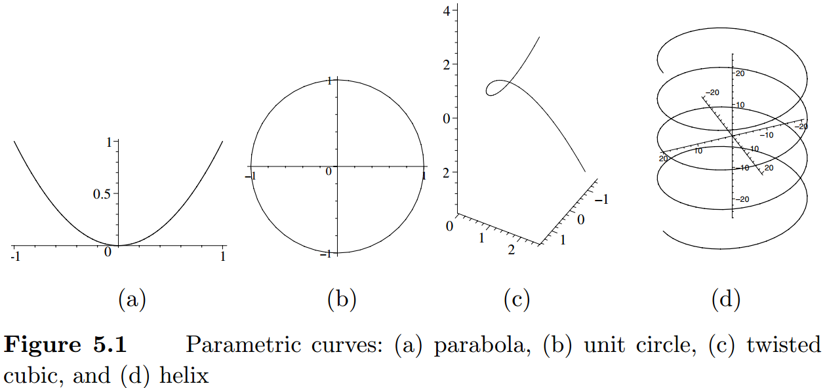
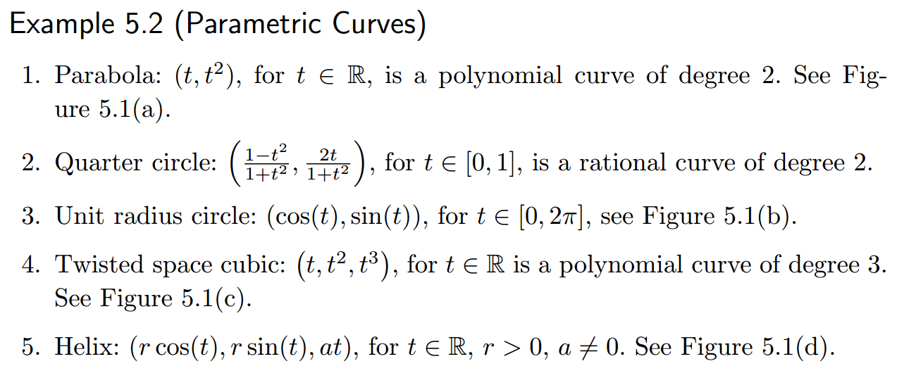
Parametric Curves

Slide 22
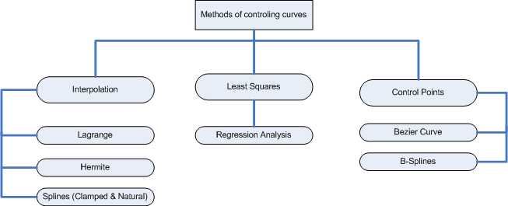
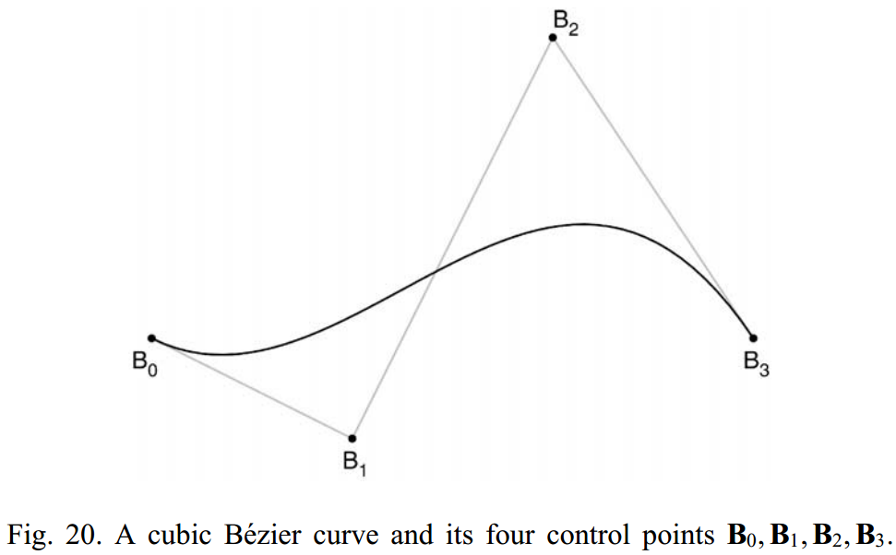
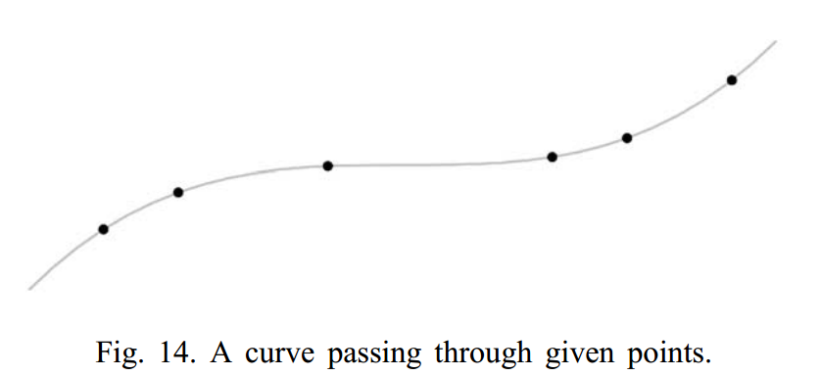
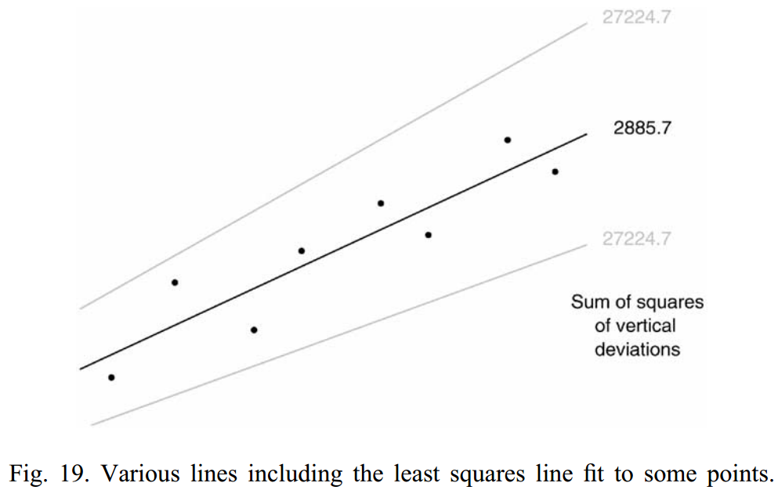
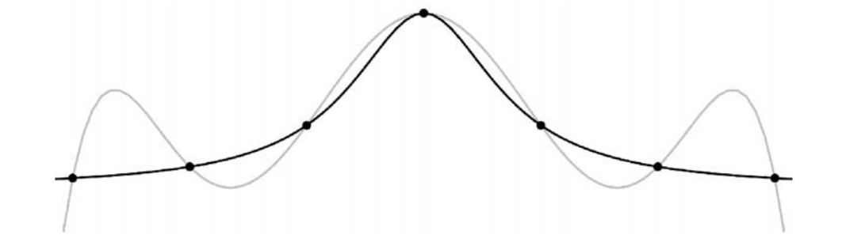
Curve controls

Slide 23
Classifications: curve design
Mechanical Spline /ducks + strips
Flexible Spline
Intrinsic curves
B- Spline
Bezier
Conics
Hermite Spline
NURBS
R-Bezier
T-Splines

Slide 24
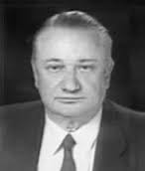
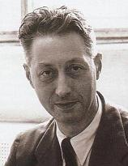
Bézier curve
born 1930 in Besançon, France.
In 1959 Citroën hired Paul de Faget de Casteljau, formulate a curve for design who just fresh from his PhD studies.
Pierre Étienne Bézier (Sept.1, 1910 – Nov. 25, 1999)
As an engineer at Renault, he became a leader in the transformation of design and manufacturing, through mathematics and computing tools, into computer-aided design and three-dimensional modeling.

Slide 25
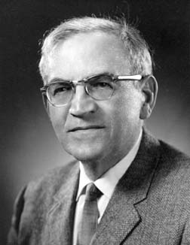

de facto for CAD systems: B-Splines
Isaac Jacob Schoenberg (April 21, 1903 – Feb. 21, 1990) was a Romanian-American mathematician
Carl-Wilhelm Reinhold de Boor (born 3 Dec. 1937) is a German-American mathematician found a better way to evaluate B-Splines.
ISI Highly Cited Author in Mathematics (at some point)

Slide 26
Ideal Curve for Design
We often wish to generate curves and surfaces
There are a number of (conflicting) goals
Interpolate (include) a set of arbitrary points
Easy and efficient to compute
Smooth (derivatives)
Local Control (vs. Global control)
Easy to deal with (easy create diff shapes)
Satisfy given geometric constraints
It is hard to get all of these…

Slide 27
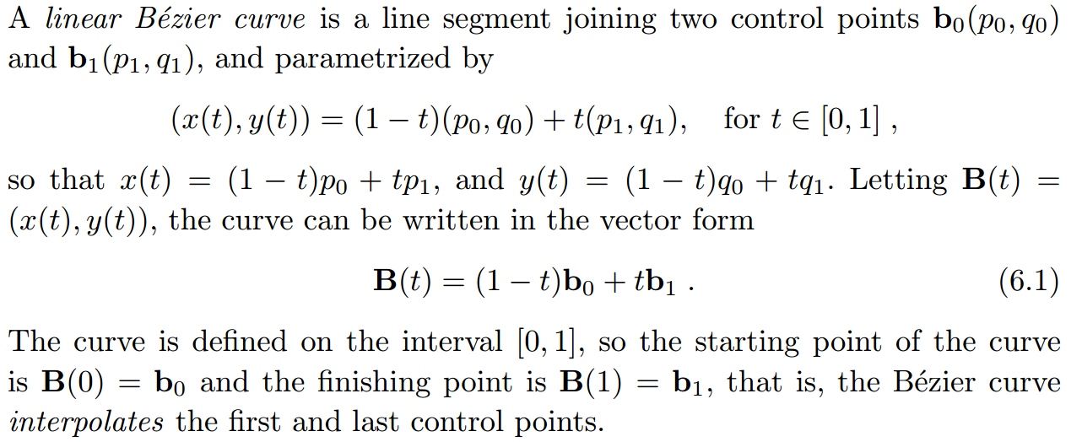

Linear Bezier Curves = a line
Coordinate function = a polynomial
Basis function

Slide 28

Beziers: characteristics
Control point
Control polygon

Slide 29


Beziers: general representation

Slide 30



Beziers: characteristics
Partition of Unity
Positivity
Symmetry
Recursion
Convex Hull Property
Invariance under transformation
3. Symmetrical control polygon results
symmetrical curve
4. de Casteljau algorithm :
easy computation!
5. Variation diminishing property
6. Endpoint Interpolation.
7. Endpoint Tangent Property.

Slide 31

Beziers: rendering using de Casteljau Algo.
Can compute any point on the curve in a few iterations
No polynomials involved
Repeated linear interpolation

Slide 32
de Casteljau algorithm
Degree 3, t=0.75

Slide 33


Rational Bezier: more shape control

Slide 34

Bezier Curves: applications
Path design
outline of a glyph

Slide 35

Continuity and Bezier control points

Slide 36



Sneak peek: Bezier Surface.
Tensor product
Notes:
Konstruktion eines Flächenpunkts mit Hilfe von de-Casteljau:
Def.: Die Fläche heißt Bézier-Fläche vom Grad (m,n) mit den Kontrollpunkten b00,…,bnm

Slide 37
B-Splines
Mathematics of shapes

Slide 38



Motivation: B-Spline Basis
Bézier curve of degree 11
three Bézier curve segments of degree 3
B-spline curve of degree 3 (8 control points)

Slide 39
B-Spline Curves (Two Advantages)
The degree of a B-spline polynomial can be set independently of the number of control points.
B-splines allow local control over the shape of a spline curve (or surface)

Slide 40
Bezier Vs B-spline: Something special about BSpline
Parameter t defined in [0,1]
Many parameters: knot vectors

Slide 41

B-Spline Curves: degree increment
_{Degree 1}
_{Degree 2}
_{Degree 3}
_{Degree 4}

Slide 42



B-Spline
Evaluation?
de Boor Algorithm

Slide 43

‘many parameters’ = Knots vectors

Slide 44


How make it interpolate endpoints?

Slide 45
B-Spline: Example 1
Find the number of knots needed for a B-Spline curve which has degree = 2 and 3 control points (p₀ , p₁ & p_{n=2} ).
d=2, Control points, n=2,
→ m= n + d + 1 = 5: t₀, t₁, t₂, t₃, t₄, t₅.
b. Find the knot values such a way that it interpolates endpoints.
t₀=0, t₁=0, t₂=0, t₃=1,t₄=1,t₅= 1
c. Find nu of segments within this B-spline.
[t_{d}, t_{m-d}] = [t₂, t₅₋₂₌₃] = [t₂, t₃]= [0, 1]
d. Finally, find the equation of B-Spline curve in polynomial form.

Slide 46
Non-periodic (open) uniform B-Spline
Answer d:
To obtain the basis function,
B(t) = ∑ N_{i,d}(t)p_{i}
= ∑ N_{i,2}(t)p_{i}
= N_{0,2}(t)p₀ + N_{1,2}(t)p₁ + N_{2,2}(t)p₂
2. Firstly, find the N_{i,d}(t) using the knot value that shown above, start from d =0 to d=2.
n
i=0
2
i=0

Slide 47
Non-periodic (open) uniform B-Spline
n=?, d=2, m=n+d+1 =?
[t_{d}, t_{m-d}] =
Number of segments?
Each set of control points?
_{Degree 2}

Slide 48
Non-periodic (open) uniform B-Spline
n=?, d=4, m=n+d+1 =?
[t_{d}, t_{m-d}] =
Number of segments?
Each set of control points?
_{Degree 4}

Slide 49


B-spline’s characteristics

Slide 50

Local control

Slide 51

Continuity

Slide 52
Types of B-Spline: based on knot vectors
B-spline:
Control points
Open:
Values of knot vector?
Closed:
B0=Bn+1
Uniform
weights
Non uniform
Periodic
Conic sections
NURBS
Endpoint interpolating

Slide 53







Types of knot vectors

Slide 54

Open & closed B-Spline

Slide 55


Slide 56

NURBS curves of degree 2 to represent a circle

Slide 57
surfaces
Mathematics of shapes

Slide 58

B-Spline Surface

Slide 59


Properties of B-Spline Surfaces

Slide 60

Properties of NURBS Surfaces

Slide 61


Tensor Product: NURBS

Slide 62

surfaces
Mathematics of shapes

Slide 63


Developable surface

Slide 64


Undevelopable surfaces

Slide 65


Undevelopable surfaces

Slide 66
LACs
Towards aesthetic design

Slide 67


LAC developed similar to design practice!

Slide 68

Log-Aesthetic Curves (LACs)
Quasi-Aesthetic curves
Conventional Curves
GCS
GLAC
Bézier
B-spline
NURBS
* Fairing process to achieve monotonic curvature profiles
Constrained
Bezier Spiral
Class A Bézier
Log-aesthetic curves
Natural spirals
Logarithmic spiral
Clothoid
Neilsen’s spiral
Circle involute

Slide 69

House Design by T.Suzuki
APPLICATION OF LOG-AESTHETIC CURVES TO THE EAVES OF A WOODEN HOUSE www.mukogawa-u.ac.jp/~iasu2016/pdf/iaSU2016_proceedings_117.pdf

Slide 70




Slide 71






Path Planning: idea from highway design
bi-clothoid: an unique solution always exist
BAASS K. (1984),Transportation Forum, 1(3), 47–52
D.S. MEEK and D.J. WALTON (1989),Journal of Computational and Applied Mathematics 25 (1989) 69-78

Slide 72


Minimum variation log-aesthetic surfaces: approx. isoparametric curves into log-aesthetic curves.
Sho Suzuki, R.U. Gobithaasan, Péter Salvi, Shin Usuki, Kenjiro T. Miura, Minimum variation log-aesthetic surfaces and their applications for smoothing free-form shapes, Journal of Computational Design and Engineering 5 (2018) 243–248

Slide 73
Thank You

